Slide 1
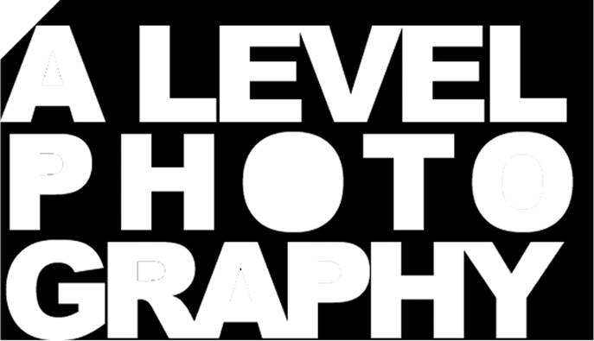
Light
The Photographer’s Paint

Slide 2
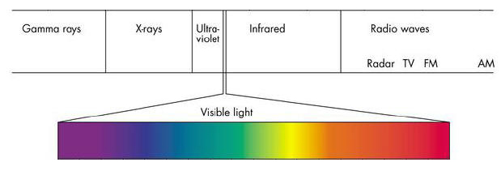
Light is that part of the electromagnetic spectrum which is visible to the human eye. It is a type of wave energy, travelling at enormous speed (186 thousand miles per second!).
Over millions of years the human eye has evolved so that it can detect the ‘visible’ part of the spectrum. Our brains perceive the different
wavelengths of light as different colours.
Some animals can see other types of electromagnetic radiation, for example snakes can also see infrared which is given off by hot objects, helping them to locate prey.

Slide 3
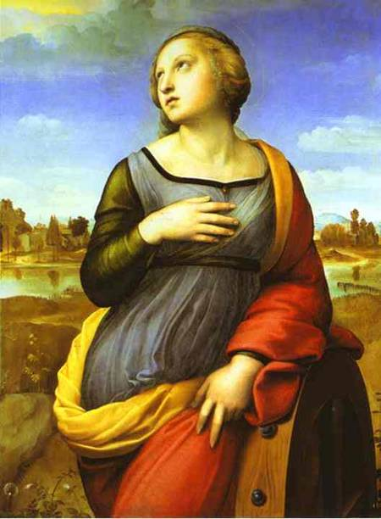
Artists long ago realised that to make a painting look realistic they needed to reproduce the way that light actually behaved.
What is the direction of light in this painting by Raphael? (Where is the light coming from?)
Raphael, St Catherine of Alexandria, 1508

Slide 4
Direction of Light
Raphael, St Catherine of Alexandria, 1508

Slide 5
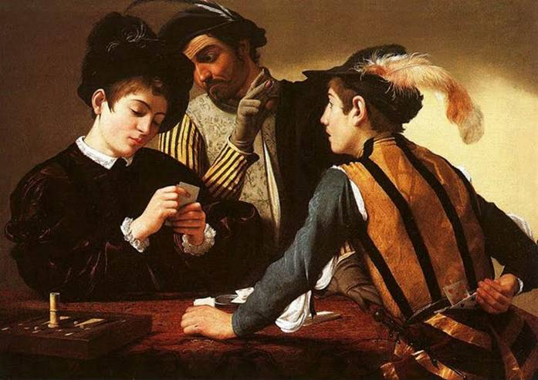
Caravaggio, The Cardsharps, 1594
Caravaggio uses light to make this painting more three-dimensional and realistic. How does he use light to achieve this?

Slide 6
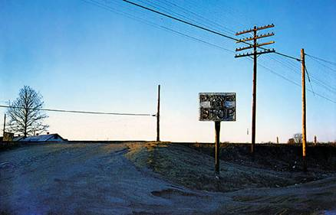
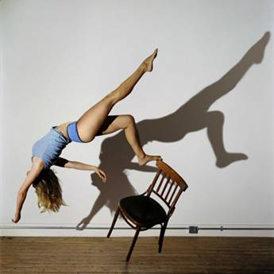
William Eggleston
Lighting is one of the most important factors in creating a ‘good’ or successful photograph.
Sam Taylor Wood

Slide 7
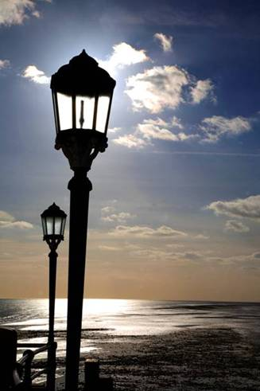
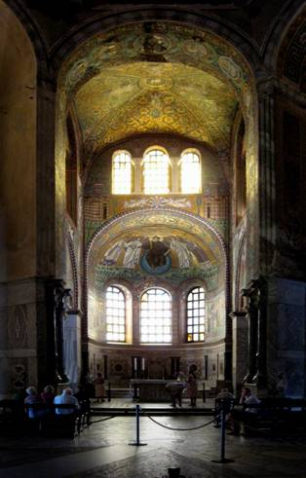
Chris Monaghan
Lighting can help emphasise a mood or feeling.

Slide 8
Shadows indicate the direction of light and help make an image look more three-dimensional and realistic.
Does this image look realistic?

Slide 9
What about now?
How does adding a shadow make the image more three-dimensional?

Slide 10
Light has several different properties for the visual artist:
Quantity – how much light – bright, dim, faint etc.
Colour – the colour or ‘hue’ of the light?
Direction – where is the light coming from?
Quality – Is it a soft gentle light, or a harsh hard light giving crisp dark shadows.

Slide 11
Quantity of Light
The amount of light that we get from a candle is clearly less than that produced by a bright torch or the sun on a bright day.
The amount of light is measured by a light Meter.
Most cameras have a built-in light meter so that the correct exposure can be given to the film or digital light sensor chip.

Slide 12
2. Colour of Light
Our eyes and brain tend not to notice any change in the colour of daylight throughout the day.
Surprisingly though, daylight is quite yellow/orange near dawn, and gets much bluer as midday approaches, finally becoming yellow/orange again as sunset approaches.
Although we do not normally notice this change in what is often referred to as the colour temperature or colour balance of daylight, cameras do record the colour difference.
Taken 11.30 am (note blue tint) Taken near sunset (note yellow tint)

Slide 13
The Impressionists were probably the first painters who actually noticed that shadows are not just shades of black and grey! They painted shadows as they actually appeared.
Note the blue tinted shadows in Monet’s The Stroll (colour of the woman’s white dress) and the green shadows in Sisley’s painting!
Claude Monet, The Stroll, 1875
To detect the colour balance of daylight look at the colour of any shadow areas.
Alfred Sisley, The Bridge, 1872

Slide 14
Warm colours (reds, oranges yellows & magentas) will give an image a different ‘feel’ to Cold colours (blues, cyan and greens).
The colour balance of an image can be varied by:
Placing a coloured filter over the camera lens.
Adjusting the colour using software such as photoshop.
Placing a coloured ‘Gel’ over any light being used to illuminate the subject.
Altering the colour balance in a digital camera’s settings.
What sort of colours have a ‘happy’ or ‘Lively’ feel?
Which are colours might suggest calmness and tranquillity?

Slide 15
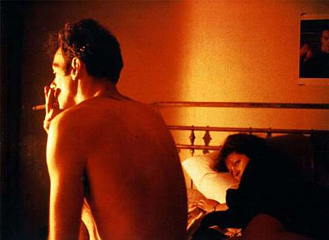
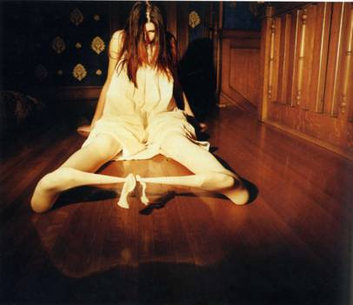
Nan Goldin
The colour of the light source can signify not only the time of day, but also the mood or atmosphere.
Anna Gaskell

Slide 16
This photograph was made using a small hand-held flashgun, fired 3 times during a long exposure at night. The flash was first fired through a red gel, then blue, then green,
Gel = a coloured piece of transparent plastic used to change the colour of a light source.

Slide 17
3. Light Direction
On planet earth the sun is normally above the eye-line. Because of this, light normally comes from above the subject.
When the light direction is from below the subject it gives a very unnatural appearance, commonly known as Horror Lighting
Film still from the Hammer horror film Dracula

Slide 18
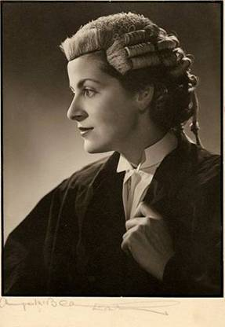
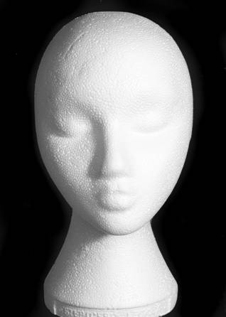
4. Quality of Light
‘Soft’ Light
Portrait of a Barrister by Angus McBean Using a soft but directional light source.
Soft light produces gentle mid-tone shadows of low contrast

Slide 19
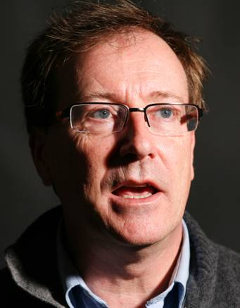
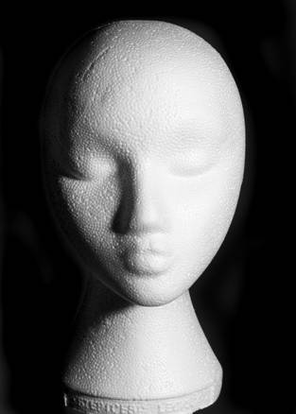
‘Hard’ Light
Hard light produces crisp dark shadows with high contrast

Slide 20
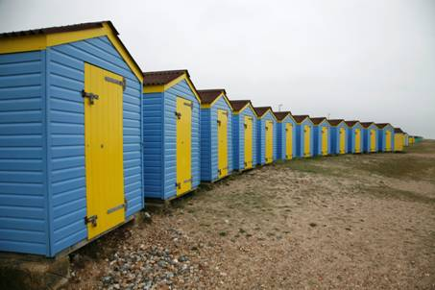
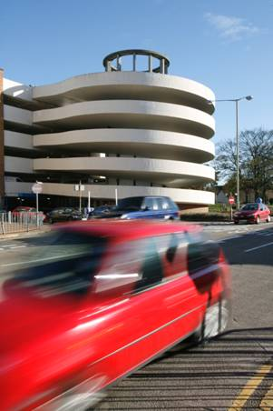
Chris Monaghan
These beach huts were photographed on a cloudy day – is the lighting soft or hard?
This urban scene was photographed on a sunny day – is the lighting soft or hard?
Chris Monaghan
What do you also notice about the different way that colours are reproduced in soft and hard light?

Slide 21
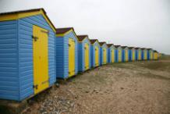
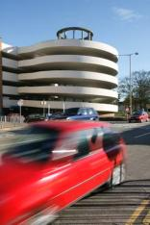
Soft light gives low contrast and low colour saturation
(the colours look a bit ‘flat’)
Hard light gives high contrast and high colour saturation
(the colours are more vivid)

Slide 22
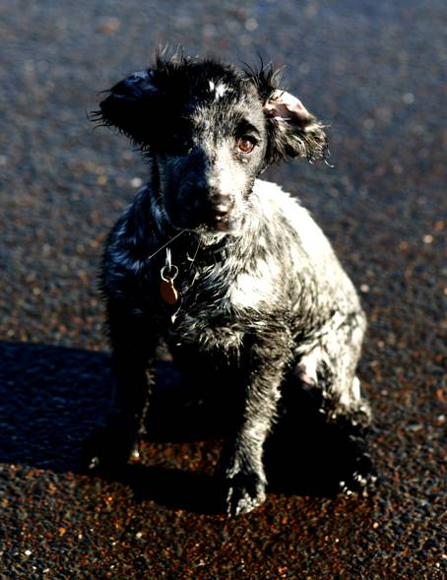
One of the problems with very hard light (as on a very bright sunny day) is that the very high contrast can mean a loss of detail in the highlight or shadow areas.
Note the way that some areas of this image have little or no information recorded in them
(see the white highlight and black shadow areas have no detail recorded in them).

Slide 23
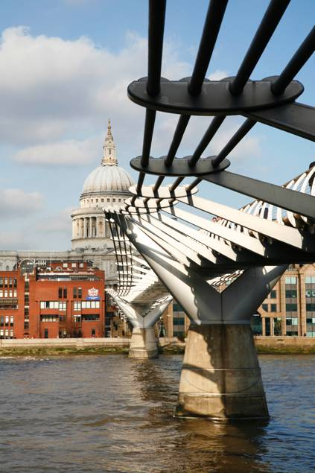
Many photographers favourite lighting for outdoor photography is found on a sunny day, but with some cloud present.
Light on this type of day is quite hard (giving good colour saturation), but the clouds help prevent very high contrast which might stop detail being recorded in both highlight and shadow areas. Another advantage is that skies are thought by many to become more interesting when they include clouds.
Chris Monaghan

Slide 24
Finding soft light on a very sunny day
If you photograph in direct sunlight, the high contrast can cause problems in capturing detail in both highlight and shadow areas - some areas appear ‘burnt out’ or completely black.
One solution to this problem is to find somewhere in the shade to photograph your subject. The light in shaded areas is usually much softer, although this will also mean lower contrast and colour saturation.
Soft light in shadow areas
Hard light in direct sunlight

Slide 25
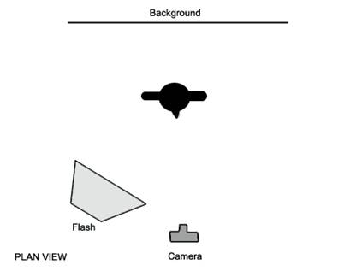
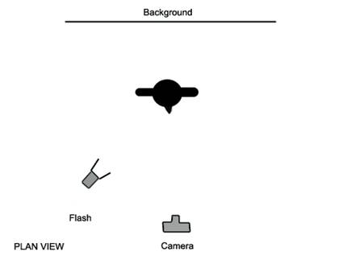
Soft light in the studio is obtained by using a flash with a large Softbox
Hard light in the studio is obtained using a flash with a small reflector

Slide 26
Hard & Soft Light & Surface Texture
Soft Light
Hard Light
Soft light tends to flatten or hide surface texture, while hard light because of its more uni-directional character tends to emphasise surface texture.

Slide 27
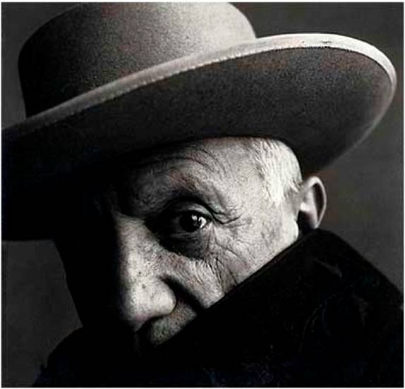
The photographer Irving Penn wanted to show the lined textured face of the artist (Pablo Picasso).
Penn therefore used a fairly hard light source.
Irving Penn, Pablo Picasso

Slide 28
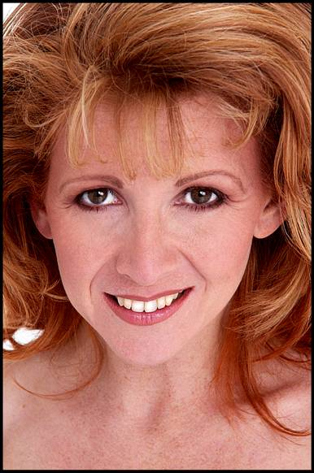
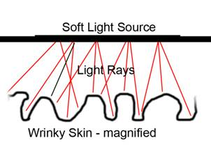
Female skin is generally thought to look more flattering without emphasising the texture (spots, lines, blemishes etc).
The photographer here has used a large softbox to give flattering soft light.
Soft light comes from large light sources and so hits the subject at many angles. This means that the light manages to get into all the little wrinkles and creases of the skin without causing shadows which would emphasise such skin blemishes.
Chris Monaghan

Slide 29
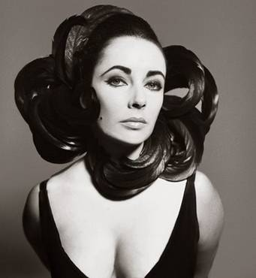
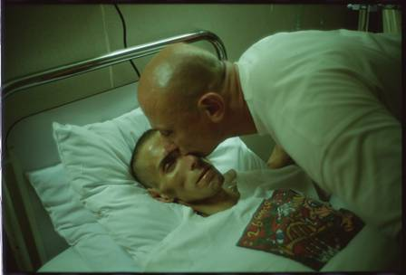
Richard Avedon
Lit with hard light – but actress Liz Taylor had excellent skin (and had good make-up on) so that few blemishes show.
Nan Goldin
Where might you find lighting with a green tint like this? How does this help us understand what is going on?

Slide 30
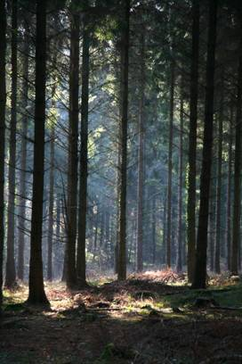
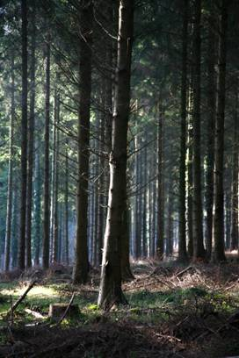
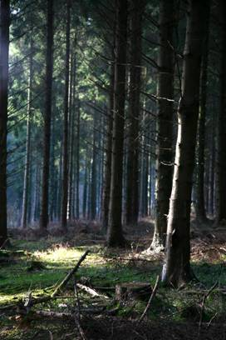
The directional lighting on these trees plays a vital role in this forest triptych (try to imagine what the images might look like if the lighting was soft and ‘flat’).
Chris Monaghan

Slide 31
Shooting into the light can create interesting silhouette effects.
Chris Monaghan

Slide 32
Photographer Philip Lorca di Corcia produced a series of images of unaware pedestrians as they walked along a busy sidewalk. He used a powerful flash so that the backgrounds became underexposed and dark.

Slide 33
Chris Monaghan
Using flash outdoors allows the photographer to control the background exposure, in this case slightly under-exposing the background and helping to draw the viewer’s attention onto the main subject.

Slide 34
Gregory Crewdson
Crewdson creates elaborately staged film-like sets and lighting

Slide 35
Fashion photography Note the large white reflector to bounce light onto the shadow side of the model (the light is coming from behind and slightly to the right of the model).
By looking around, interesting natural lighting can often be found, as with this image of a Nun.
The tiny splashes of orange light formed by the setting sun help make this image just that little more special.
Chris Monaghan

Slide 36
Summary
Light is vital for the photographic process. To create better photographs we need to be aware and in control of the following:
Quantity
how much light – bright, dim, faint etc.
Colour
the colour or ‘hue’ of the light.
Direction
where is the light coming from.
Quality
Is it a soft gentle light, or a harsh hard light giving crisp dark shadows.

