Slide 1
Wire Sculpture
The art of the Line

Slide 2
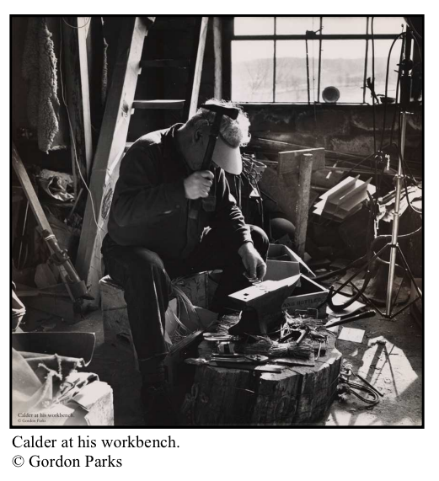
Alexander Calder-Inspired Wire Sculpture
20th Century American sculptor
1896-1976

Slide 3
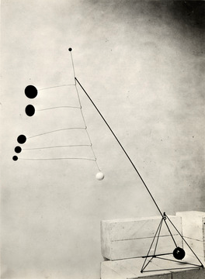
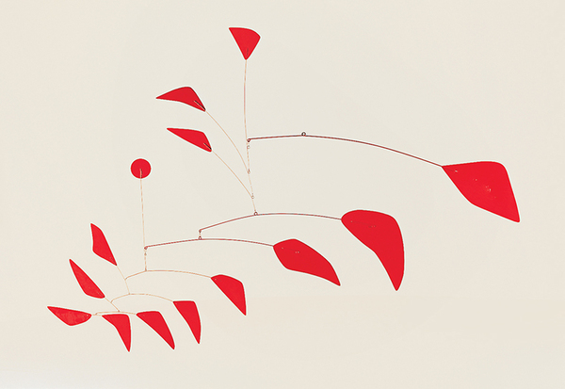
Alexander Calder-Inspired Wire Sculpture
Famous for inventing the mobile, a type of sculpture that moves.
Object with Red Discs (1931), 1931
Photograph by Marc Vaux
Big Red, 1959. Sheet metal and steel wire, 74 × 114 in.

Slide 4
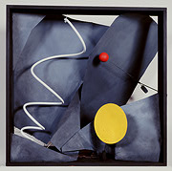
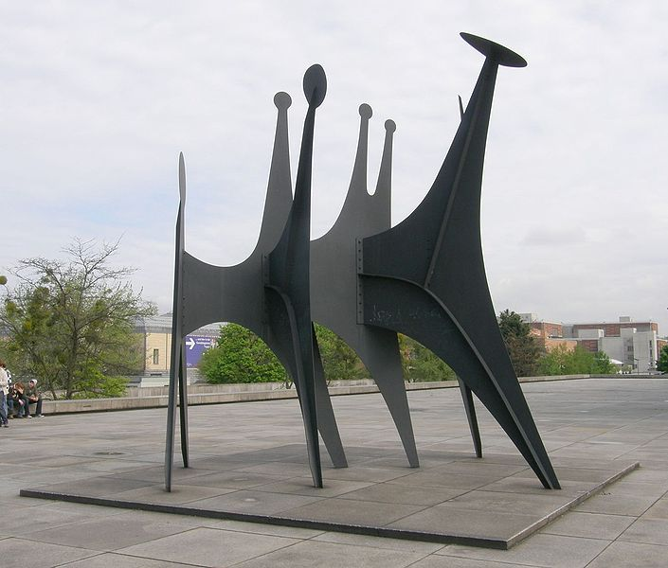
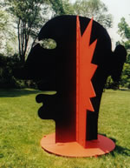
Alexander Calder-Inspired Wire Sculpture
Invented the tern ‘stabiles’ to refer to his immobile sculptures.
Black Frame, 1934
A Two-Faced Guy
Köpfe und Schwanz (Têtes et Queue)

Slide 5
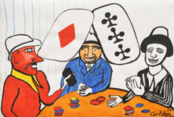
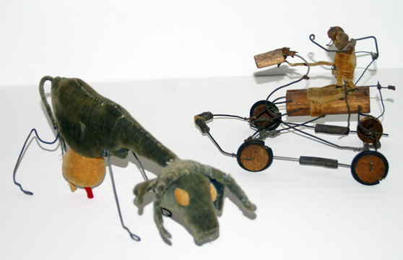
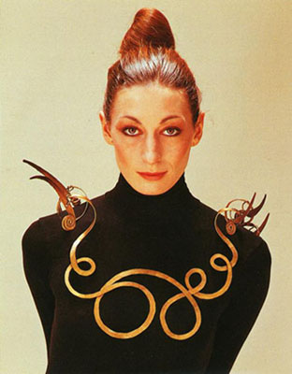
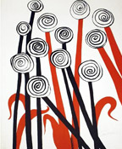
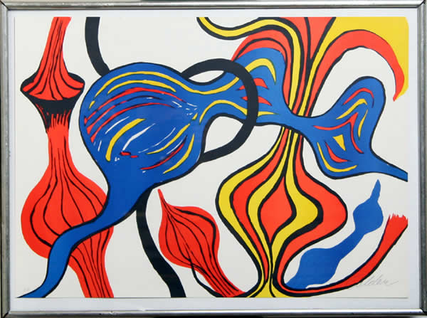
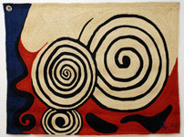
Alexander Calder-Inspired Wire Sculpture
Calder also made paintings, lithographs, toys, tapestries, and jewelry

Slide 6
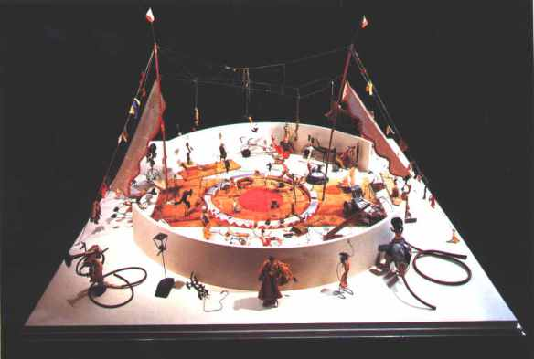
Alexander Calder-Inspired Wire Sculpture
In his first critically important work, Le Cirque de Calder (Calder’s Circus), the artist magically brought in animate objects and a band of circus characters to life using wire and recycled materials. Calder’s Circus was a miniature reproduction of an actual circus, and is considered to be the start of his lifelong interest in both wire sculpture and kinetic art.

Slide 7
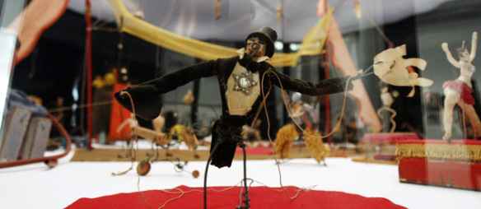
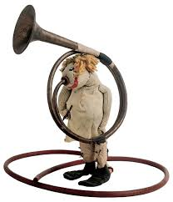
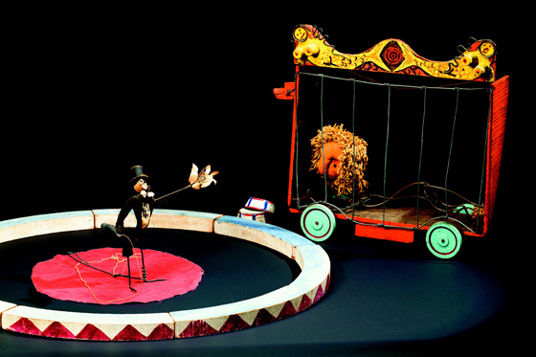
http://youtu.be/t6jwnu8Izy0

Slide 8
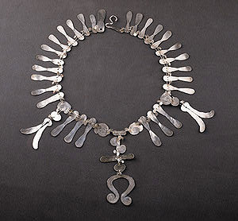
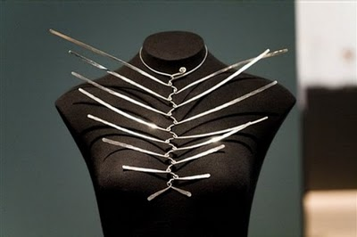
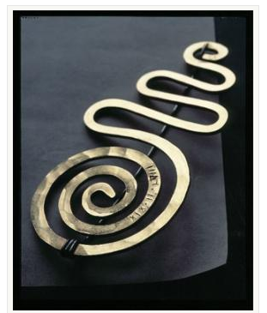
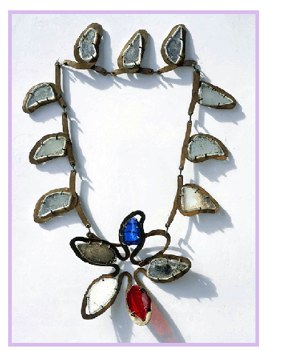
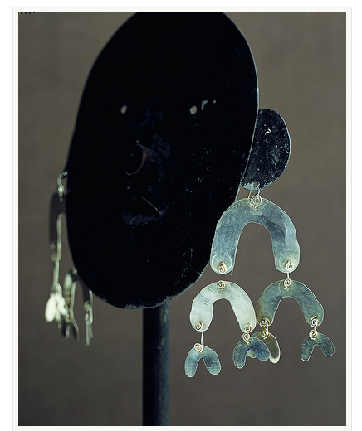
Alexander Calder-Inspired Wire Sculpture
These art forms would typify much of his later sculptural work, including the over 1,800
examples of jewelry made throughout his lifetime.

Slide 9
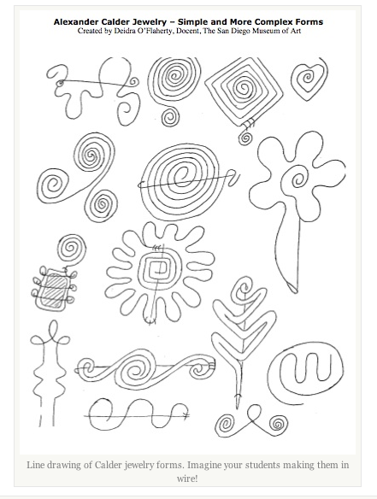
Alexander Calder-Inspired Wire Sculpture

Slide 10
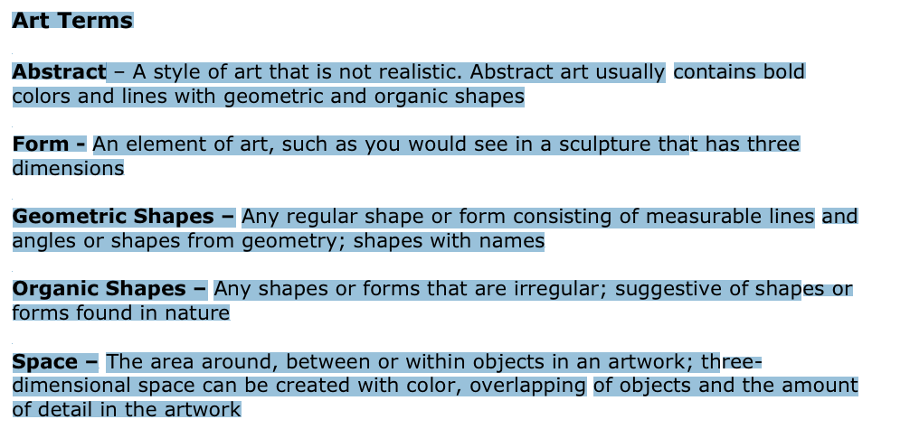
Alexander Calder-Inspired Wire Sculpture

Slide 11
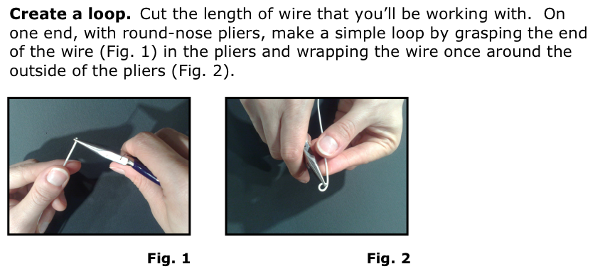
Alexander Calder-Inspired Wire Sculpture

Slide 12
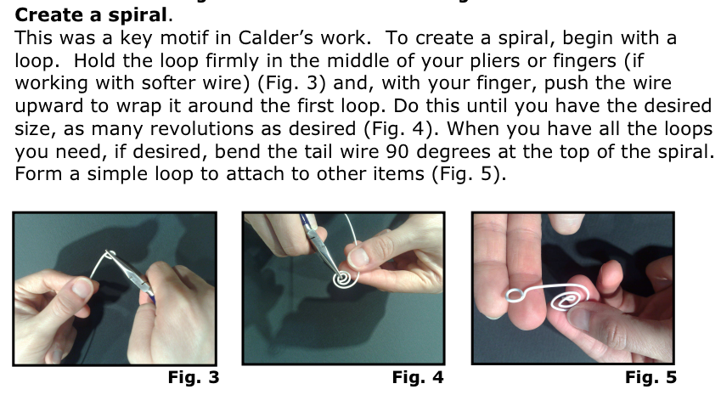
Alexander Calder-Inspired Wire Sculpture

Slide 13
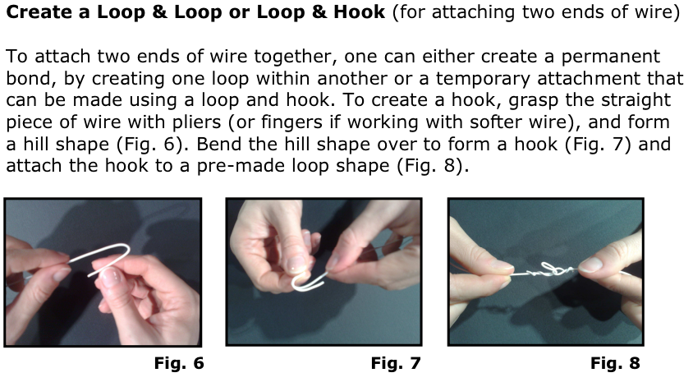
Alexander Calder-Inspired Wire Sculpture

Slide 14
Alexander Calder-Inspired Wire Sculpture

Slide 15
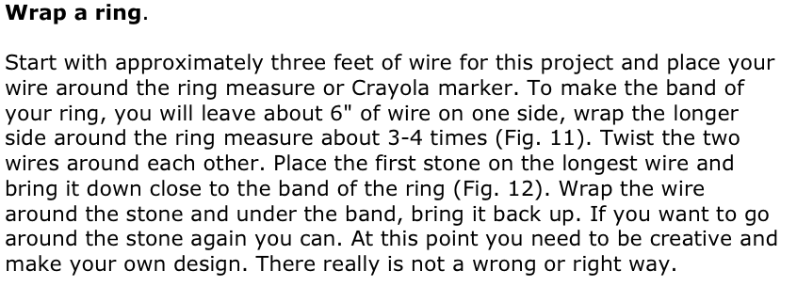
Alexander Calder-Inspired Wire Sculpture

Slide 16
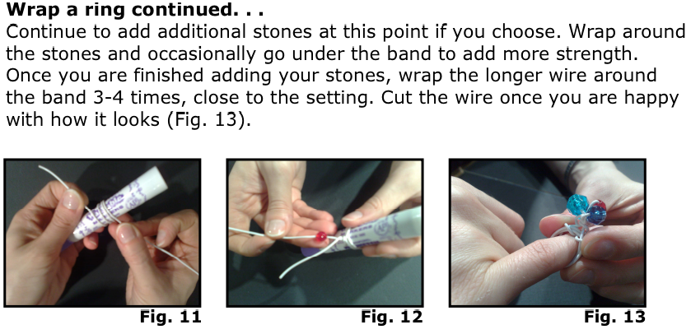
Alexander Calder-Inspired Wire Sculpture

Slide 17
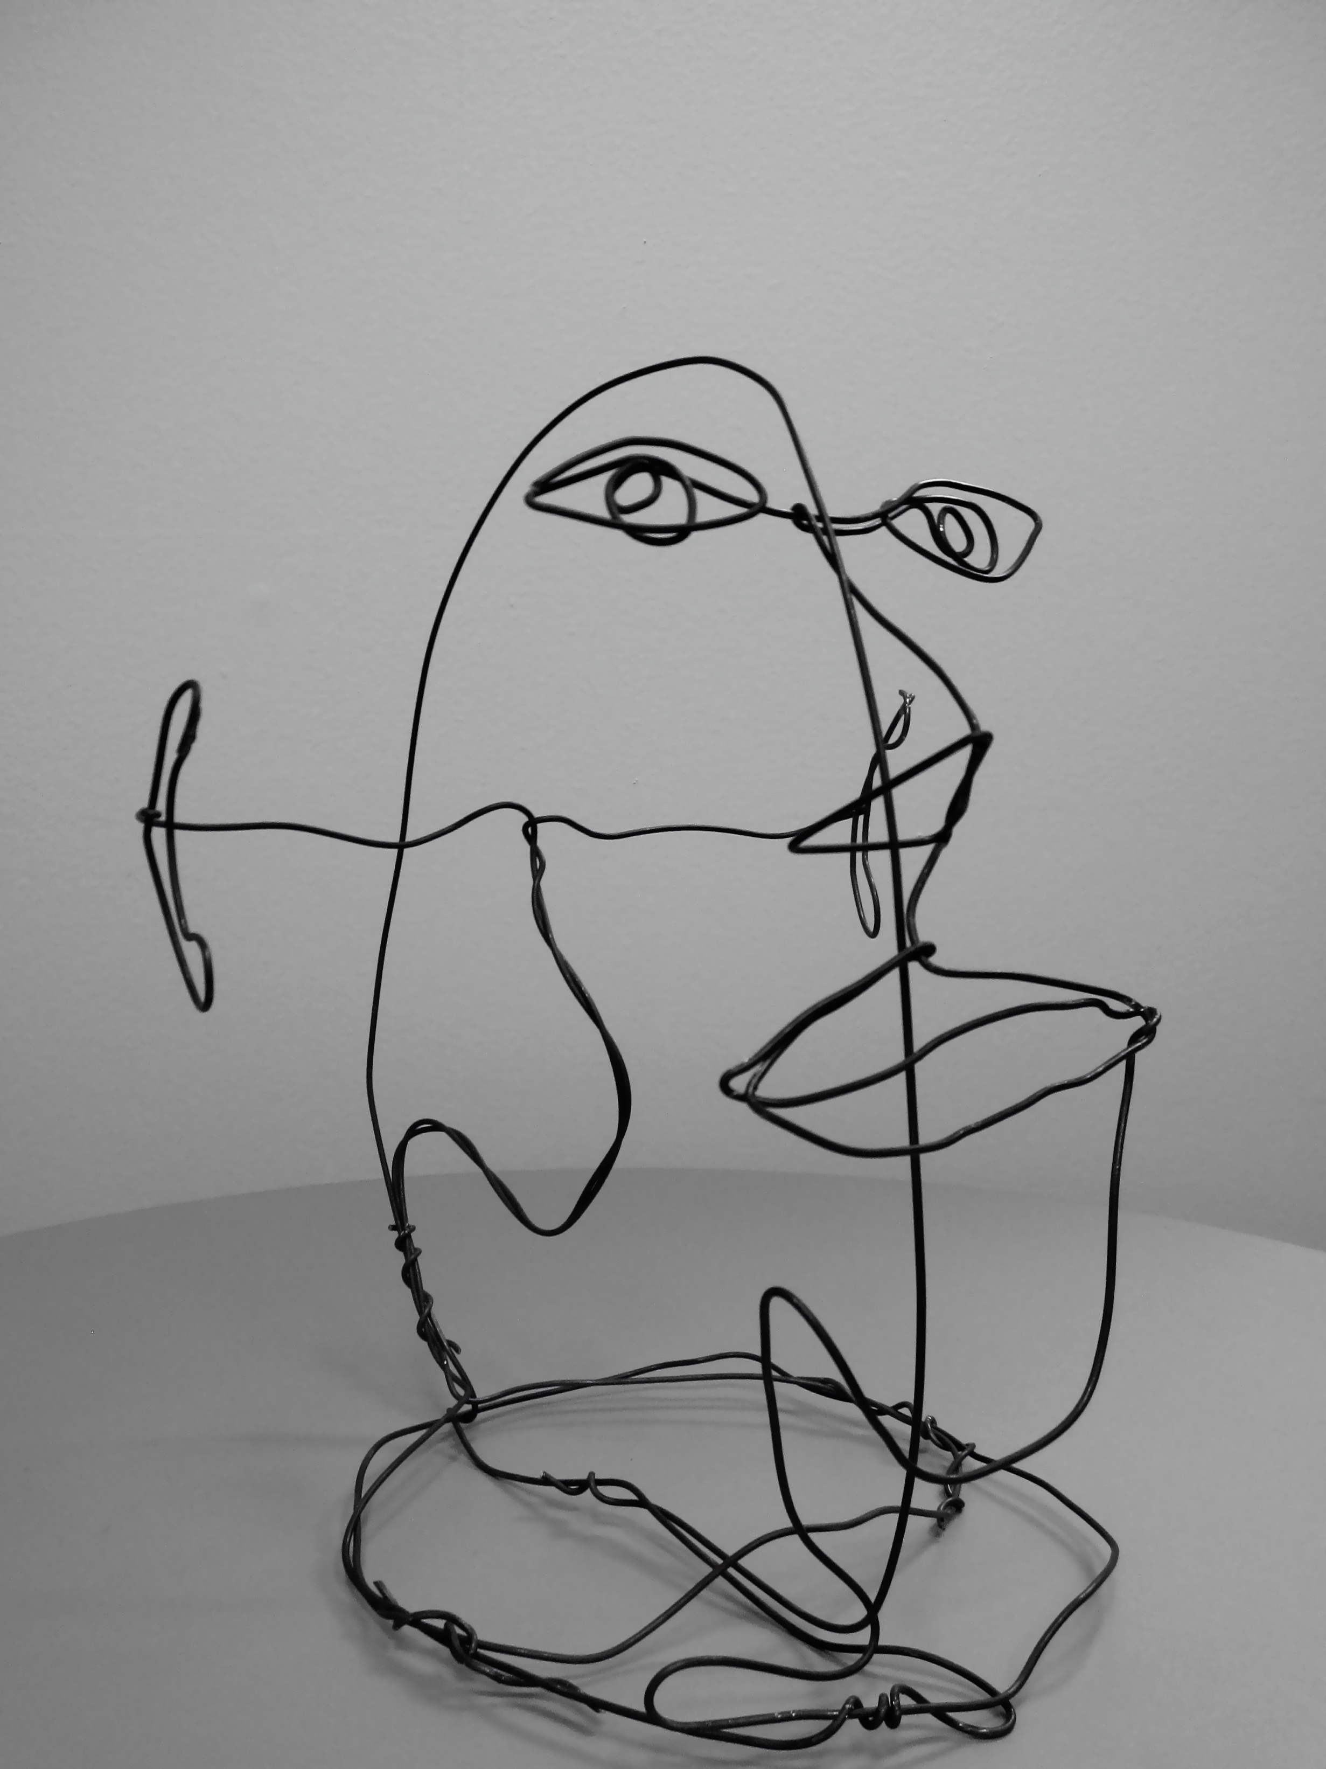
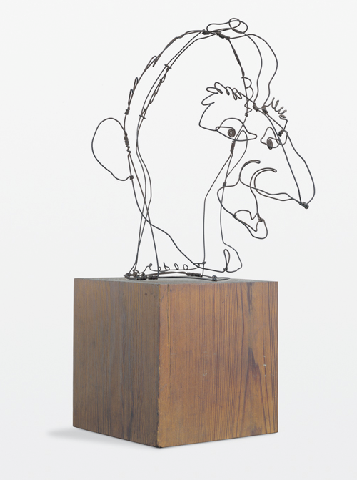
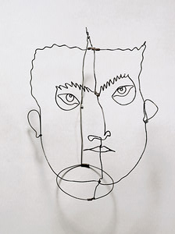
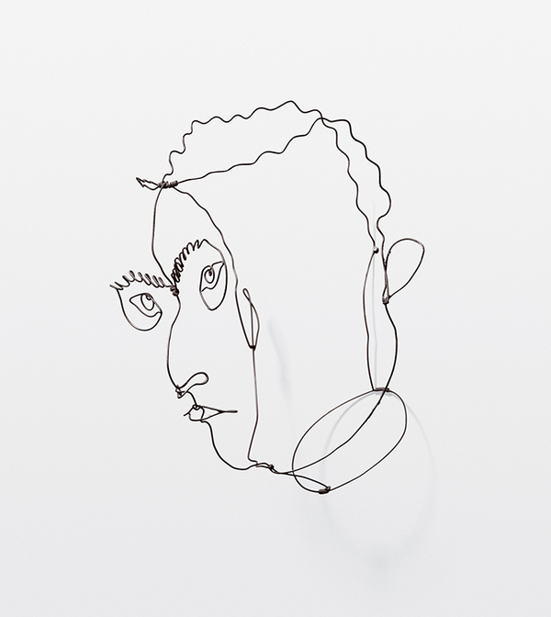
Alexander Calder-Inspired Wire Sculpture
Faces

Slide 18
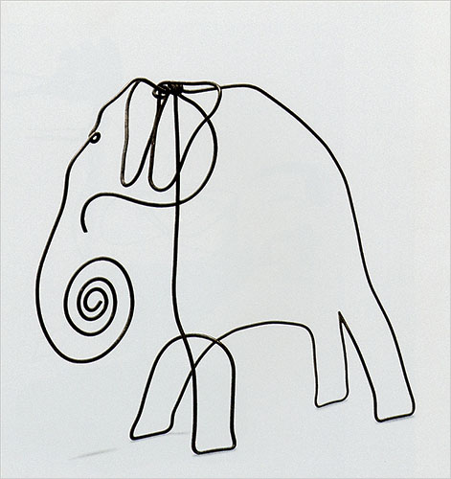
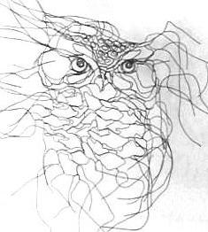
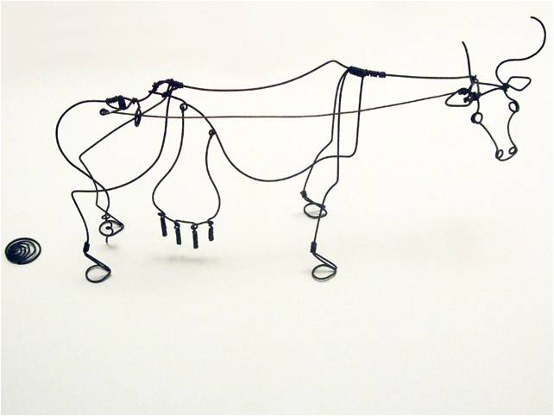
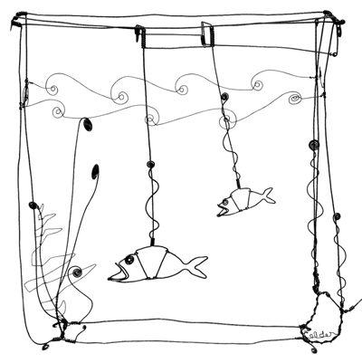
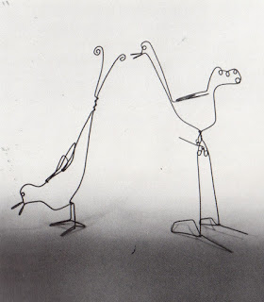
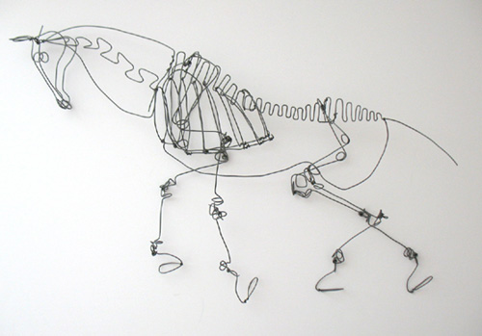
Alexander Calder-Inspired Wire Sculpture
Animals

Slide 19
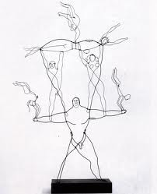
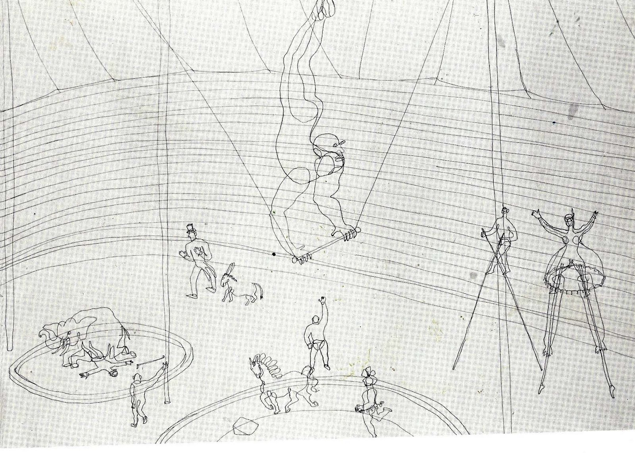
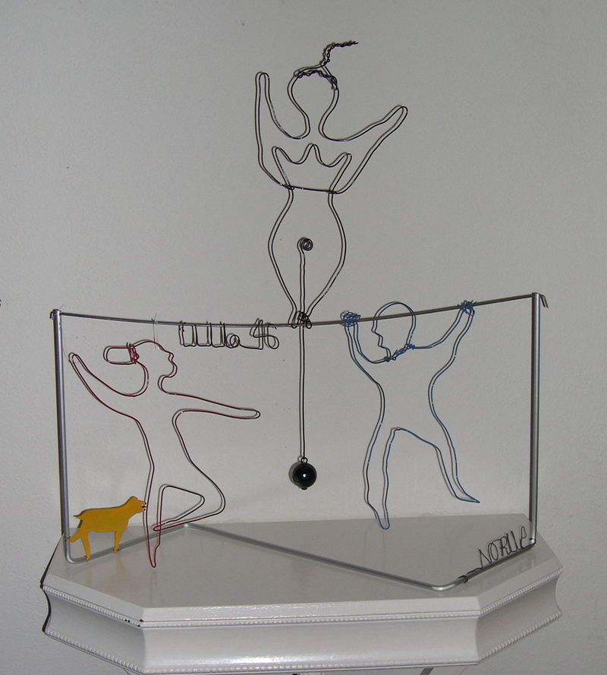
Alexander Calder-Inspired Wire Sculpture
Circus

Slide 20
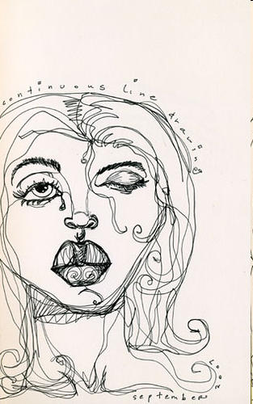
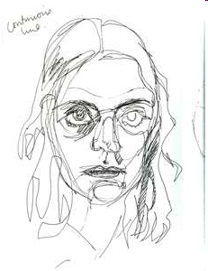
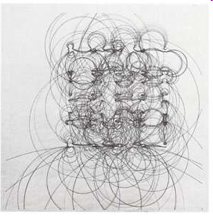
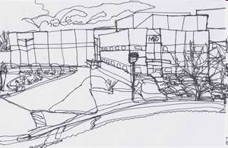
Continuous Line
Draw a scene/object/animal/person with out lifting your pen/pencil from the paper.
Think about your hat theme. You can find an image from the internet

