Slide 1
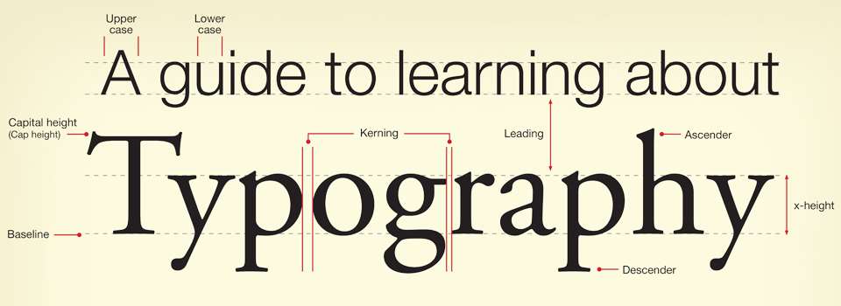

Slide 2
Fonts
Different fonts send a different message to the reader:
Sans serif
Serif
Script
Decorative

Slide 3
Sans-serif Fonts
Easy to read, especially online
Modern and clean
Good for websites or other online formats
Good for headings in printed texts
Examples include:
Arial
Comic Sans MS
Century Gothic
News Gothic MT

Slide 4
Serif Fonts
Easier to read in print
More old-fashioned or traditional
Best for the body text in print documents
Examples include:
Times New Roman
Book Antiqua
Courier New
Garamond

Slide 5
Script Fonts
Hard to read - use sparingly!
Traditional and flowery – often used on wedding invitations or menus
Examples include:
French Script MT
Pristina
Lucida Calligraphy

Slide 6
Decorative Fonts (also Display)
Hard to read – use sparingly
Good for headings
Create a fun, funky mood
Examples include:
BeesKnees
Curlz MT
Harlow Solid Italic
Jokerman

Slide 7
Grunge Fonts
Deteriorated fonts
Designed to appear “beaten up” with parts of the characters missing or misshapen

